Slide 1
REPORT TRAINING Trial Project
Part of the project PlanIT
Author: Nguyễn Chí Hải
2023

Slide 2
CONTENTS REPORTS
01. | Technology using
02. | Introduction To Trial Project
03. | Demo Trial Project
04. | Summary

Slide 3



Technology Using
Front end
API
Vue.js
LocalDB
Source control
GitHub
1

Slide 4
Introduction To Trial Project
PlanIT is a big website that you guys are developing. This is a website to manage medical equipment of a hospital. It is divided into different sections like catalog, projects, templates, admin. In each project is divided into parts such as details, buildings, levels, departments, rooms, items, history. My task is to re-code the features of the building section in the project section on my personal computer.
2

Slide 5
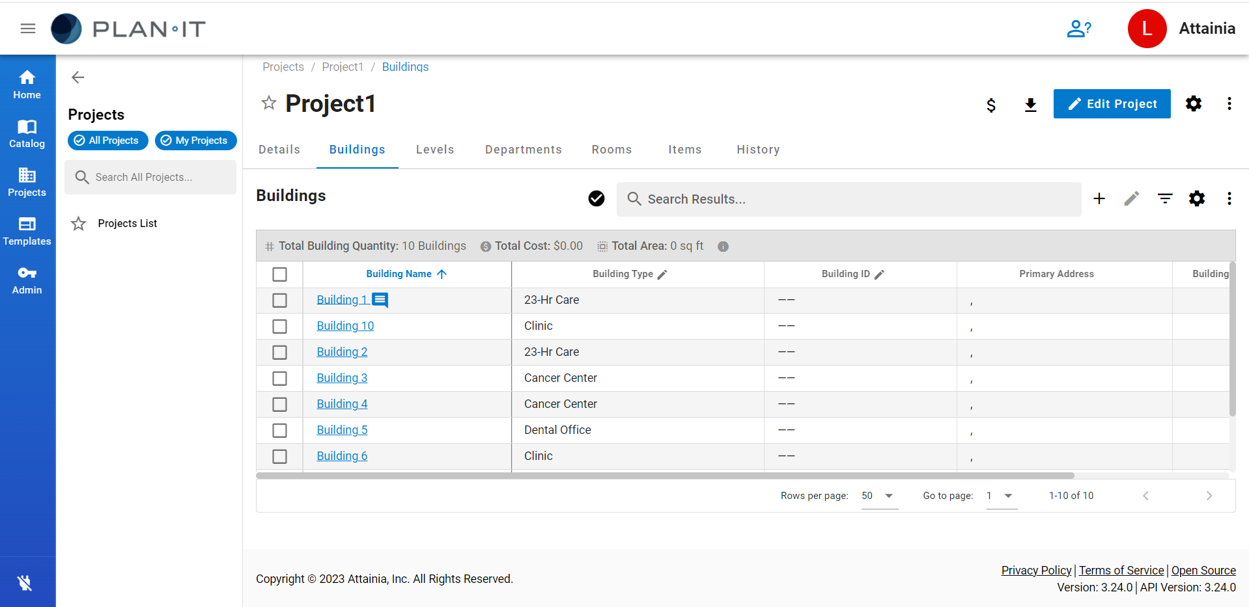
Introduction To Trial Project
2

Slide 6
Introduction To Trial Project
Project feature
Show building list.
Create, Edit, Duplicate, Delete Building.
Search, Filter, Sort Building.
Scroll to top, Pagination, Inline edit, Resize columns.
Table settings.
Comment in building.
3
Notes:
kjkjkzxc

Slide 7
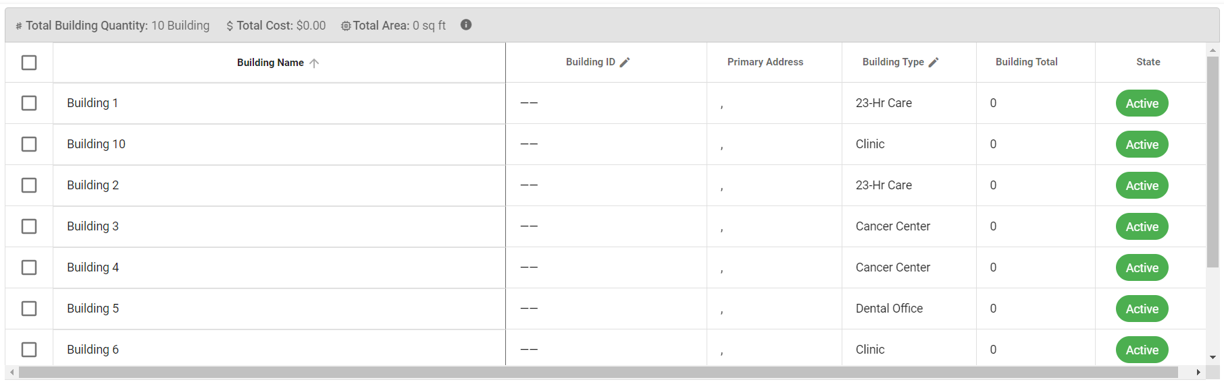
Introduction To Trial Project – Show building list
4

Slide 8
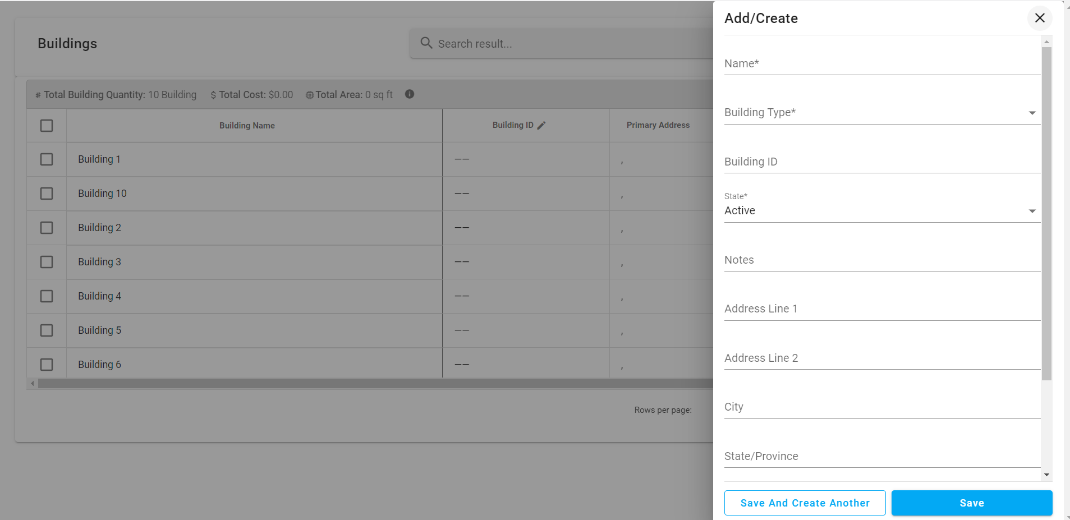
Introduction To Trial Project – Create building
5

Slide 9
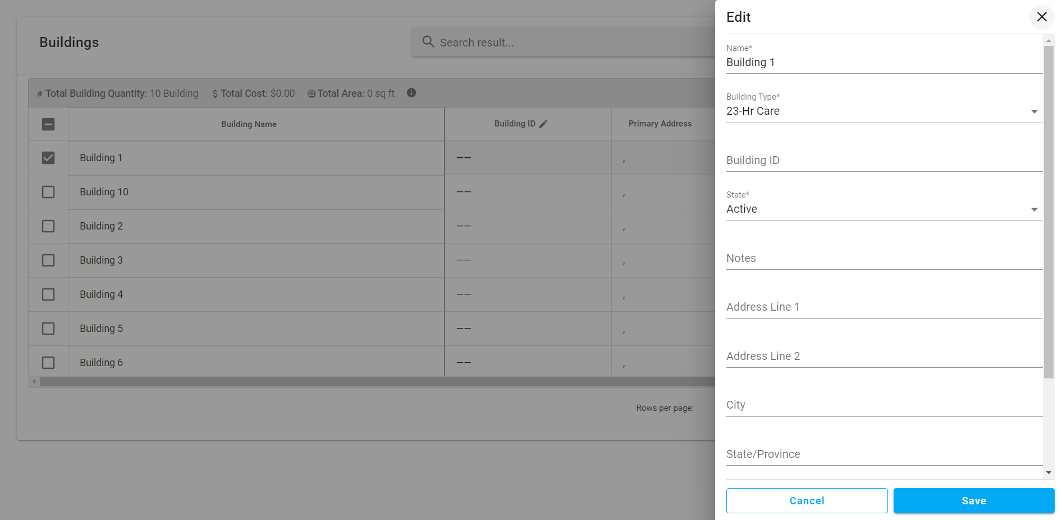
Introduction To Trial Project – Edit building
6

Slide 10
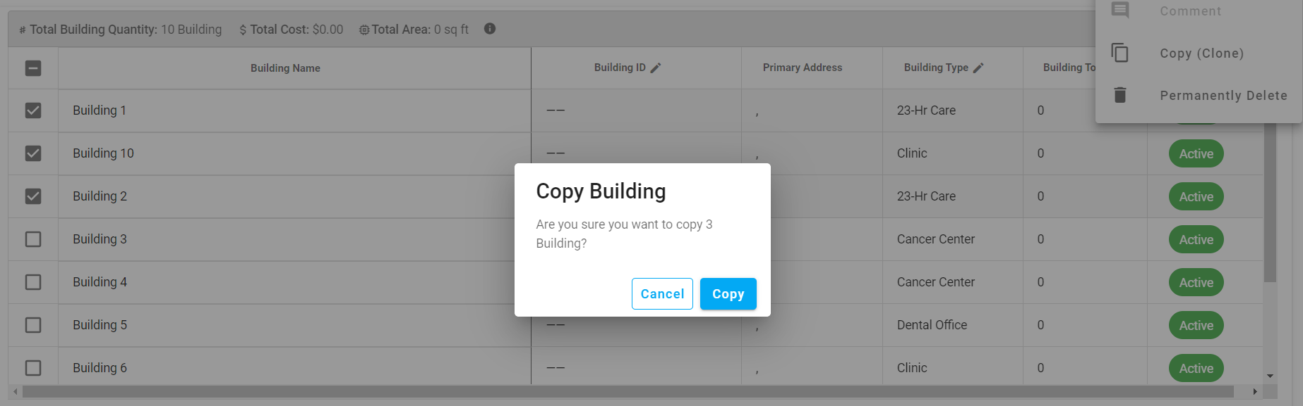
Introduction To Trial Project – Duplicate building
7

Slide 11
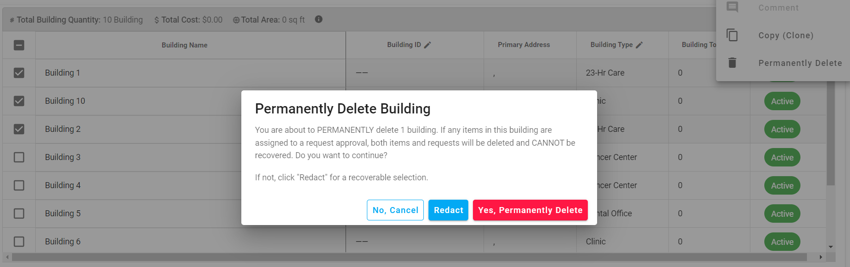
Introduction To Trial Project – Delete building
8

Slide 12
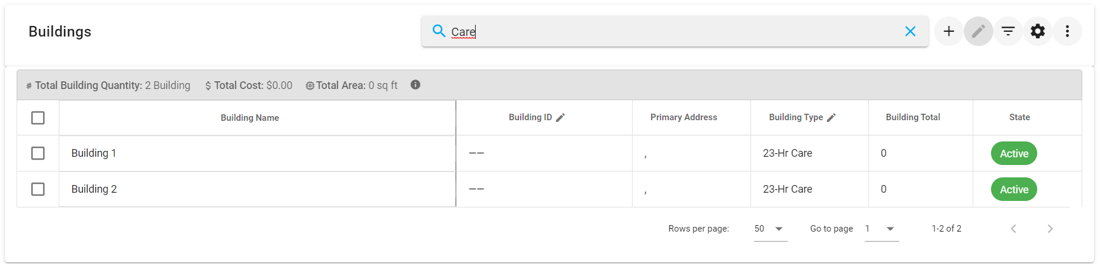
Introduction To Trial Project – Search building
9

Slide 13
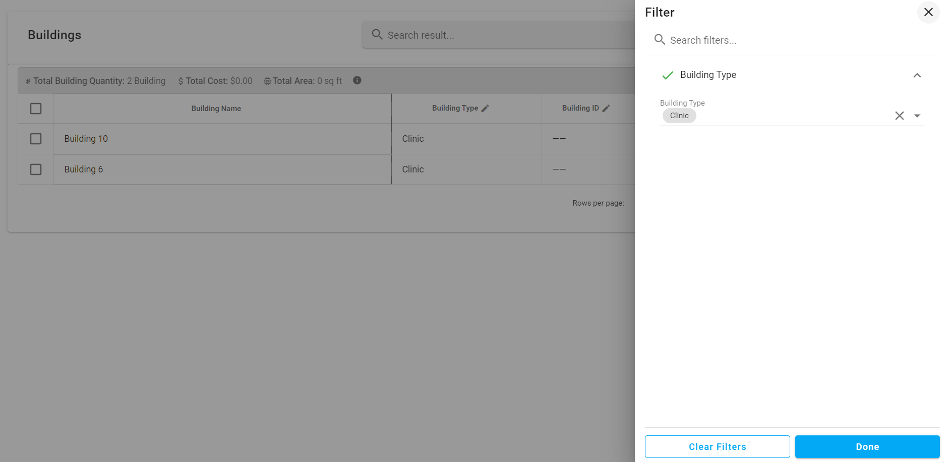
Introduction To Trial Project – Filter building
10

Slide 14
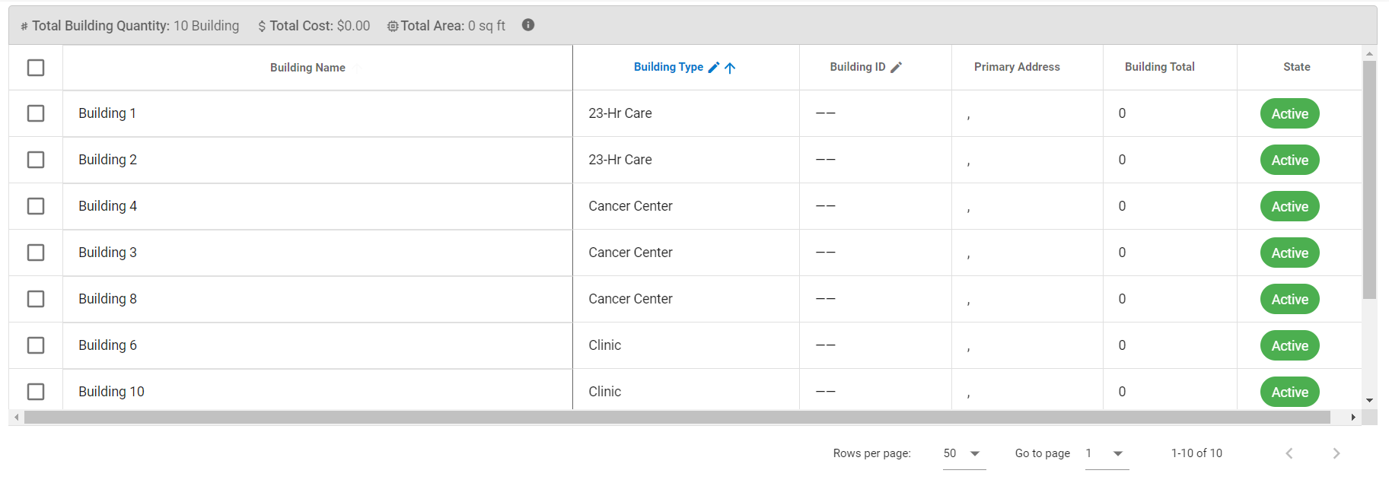
Introduction To Trial Project – Sort building
11

Slide 15
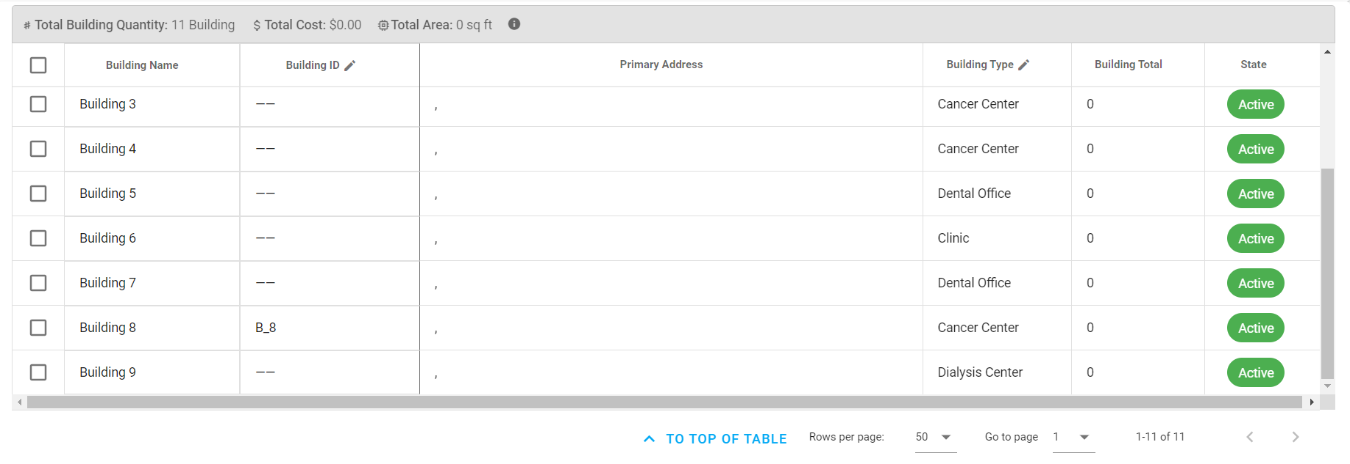
Introduction To Trial Project – Scroll to top
11

Slide 16
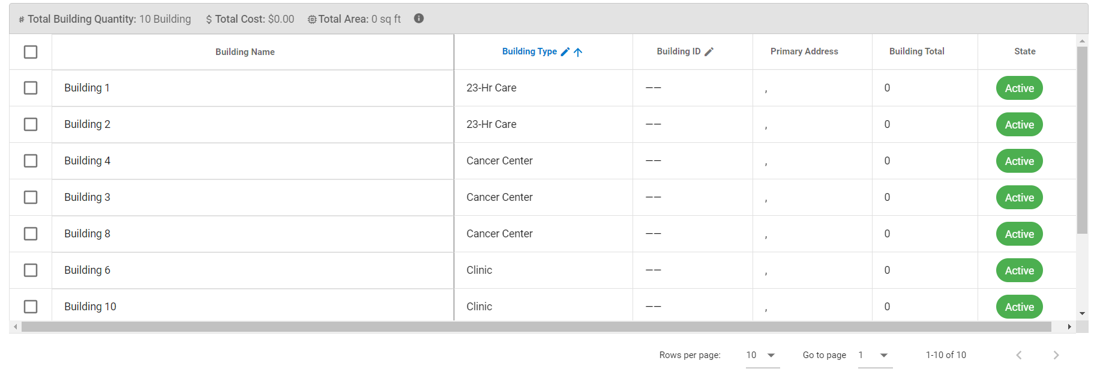
Introduction To Trial Project – Pagination
12

Slide 17
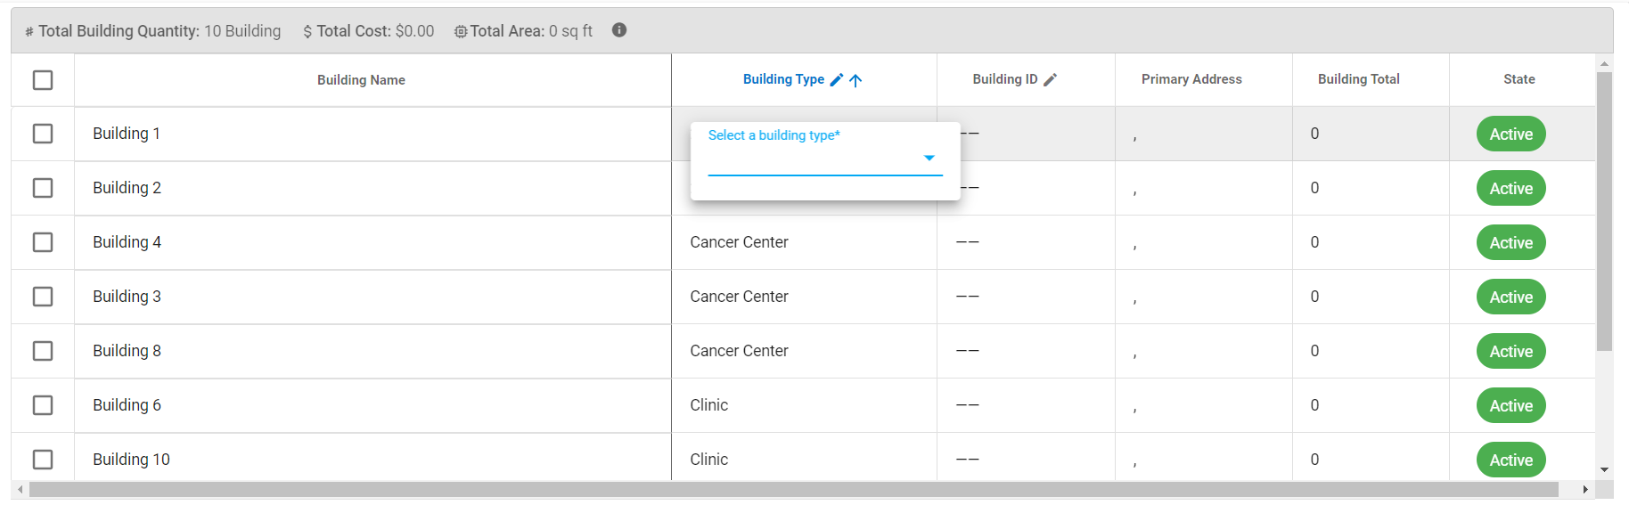
Introduction To Trial Project – Inline edit
12

Slide 18
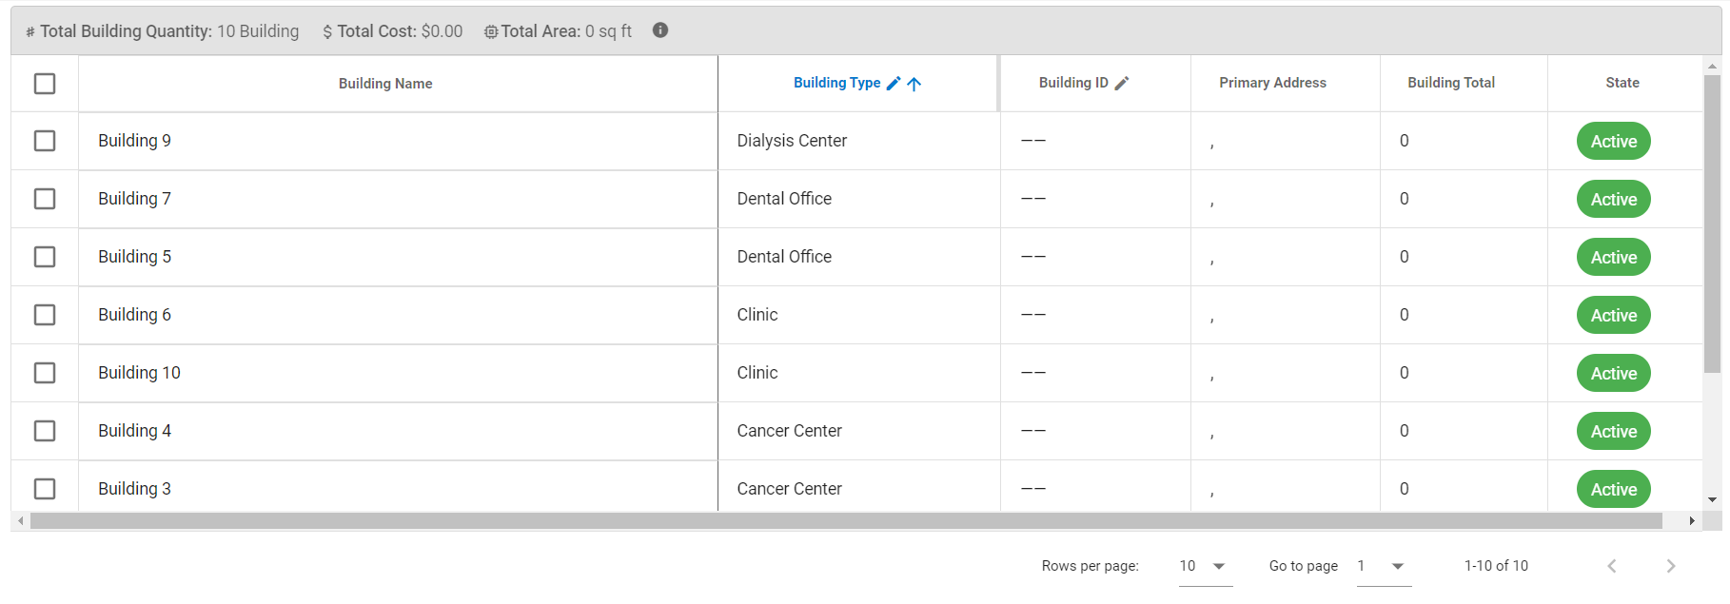
Introduction To Trial Project – Resize columns
12

Slide 19
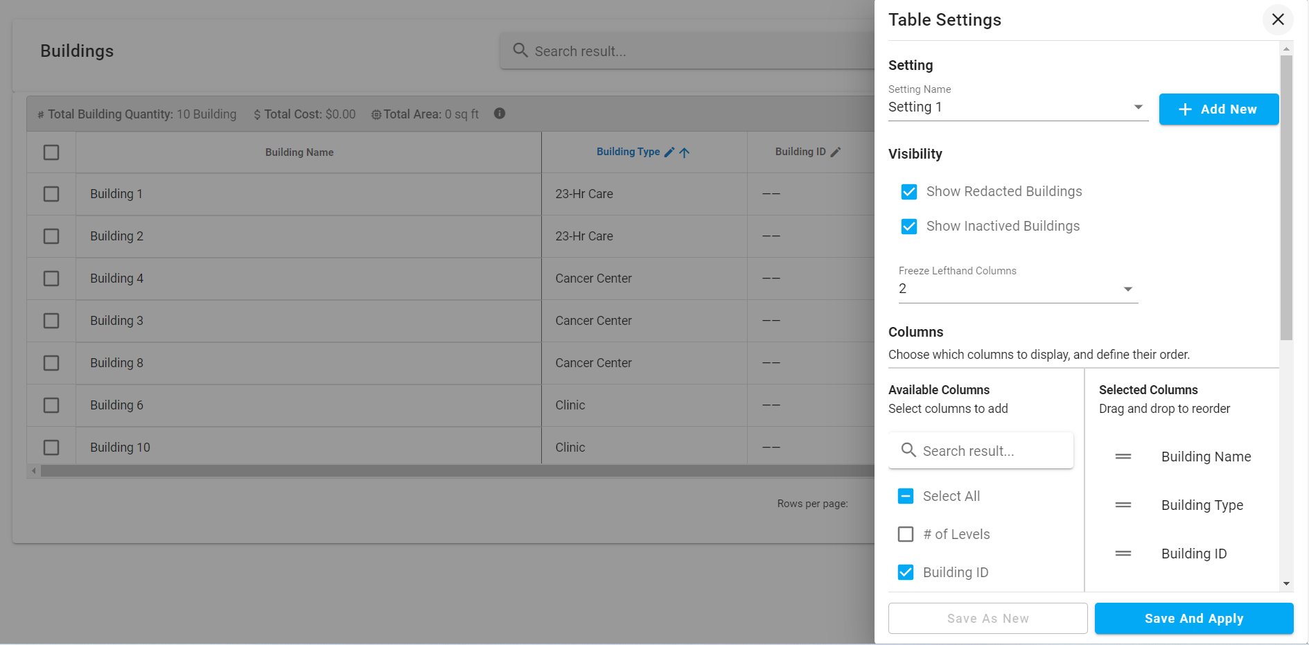
Introduction To Trial Project – Table settings
12

Slide 20
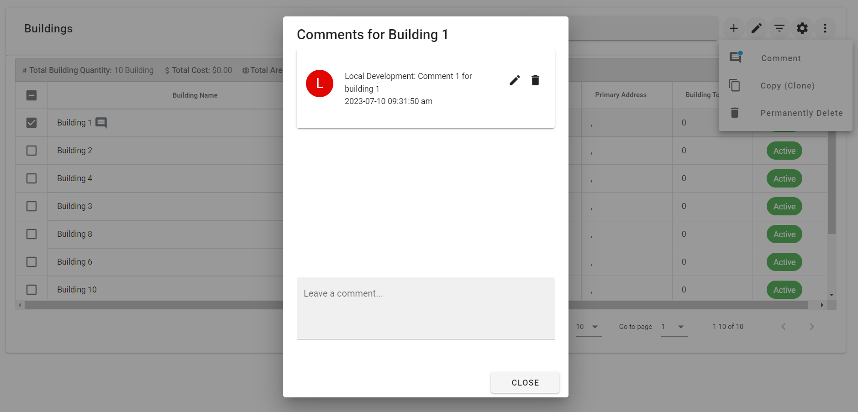
Introduction To Trial Project – Comment in building
12

Slide 21
Introduction To Trial Project – API
Auth
Method | Url | Description | Sample valid request body
GET | /api/auth/login/ | Login | JSON
Building
Method | Url | Description | Sample valid request body
GET | /api/buildings/ | Get list building
GET | /api/buildings/{idBuilding}/ | Get building by id
POST | /api/buildings/ | Create building | JSON
POST | /api/buildings/copy/ | Duplicate buildings | JSON
PATCH | /api/buildings/{idBuilding} | Edit building | JSON
PATCH | /api/buildings/bulk/ | Redacted building | JSON
DELETE | /api/buildings/bulk/ | Delete building | JSON
18

Slide 22
Introduction To Trial Project – API
Settings
Method | Url | Description | Sample valid request body
GET | /api/org-members/{idProject}/preferences/buildingsColumns/ | Get table settings
PUT | /api/org-members/{idProject}/preferences/buildingsColumns/ | Edit table settings | JSON
Comment
Method | Url | Description | Sample valid request body
GET | /api/comments/ | Get comments
POST | /api/comments/ | Create comment | JSON
PATCH | /api/comments/{idComment}/ | Edit comment | JSON
DELETE | /api/comments/{idComment}/ | Delete comment
18

Slide 23

Demo Trial Project
18

Slide 24
Summary
Result
Learning how to build UI with Vue.js and Vuetify library.
Understanding how Vuex works.
Understanding how to work with the BE through the axios library.
Result not achieved
Resize columns feature is not complete yet.
When shrinking a column until the table size is less than 100%, instead of just the back column widening, all the remaining columns widen to make up the gap .
When shrinking the freeze column, the table will get a space due to the left property of the css.
20

Slide 25





Thank You!
Headquarter: Waseco Tower, Block C, 3rd Floor, 10 Pho Quang, Ward 2, Tan Binh District, HCMC
Phone number: +84 28 3991 2068
Contact email: sales@tpssoft.com
Website: https://www.tpssoft.com/
https://www.facebook.com/tpssoft
https://www.linkedin.com/company/tpssoftware
https://twitter.com/tps_soft
https://clutch.co/profile/tps-software

